Slide 1


hs-cTn – Optimizing the Diagnosis of Acute Myocardial Infarction/Injury in Women (CODE-MI): a multi-centre stepped-wedge cluster-randomized controlled trial
Dr. Karin Humphries and Dr. Jim Christenson
on behalf of CODE-MI Investigators
National Clinical Trial Identified Number: NCT03819894

Slide 2
Overall Objective
To evaluate the impact of using the female-specific 99th percentile threshold for high-sensitivity cardiac troponin (hs-cTn), compared to the overall 99th percentile threshold, on the diagnosis, treatment and outcomes of women presenting to the emergency department with cardiac chest pain.

Slide 3
What We Know
Compared to men, women with acute coronary syndrome (ACS):
Higher risk of short- and long-term mortality, particularly among younger women
Under-recognition of myocardial infarction (MI) due to atypical symptoms and equivocal ECG findings
        Under-referral to cardiology or coronary angiography or revascularization
        Under-use of evidence-based cardiac medications
        Less Obstructive CAD (i.e. MINOCA or MI without obstructive CAD); however, MINOCA not benign so identification important

Slide 4
Rationale for CODE-MI
..sex-specific 99th centiles are recommended for hs-cTn assays.”*
  Significantly lower female 99th centiles across all hs-cTn assays
Impact of female 99th centile threshold on diagnosis and outcomes are unknown
Failure to respond to differences may contribute to worse outcomes in women compared to men
*Thygesen et al. Fourth Universal Definition of Myocardial Infarction. JACC Vol 72 (18), 2018
URL= upper reference limit

Slide 5
4th Universal Definition of MI
Symptoms
ECG
Biomarkers
“the term myocardial infarction should be used when there is an acute myocardial injury with clinical evidence of acute myocardial ischemia and with detection of a rise and/or fall of cardiac troponin values with at least one value above the 99th percentile upper reference limit of a healthy population”

Slide 6
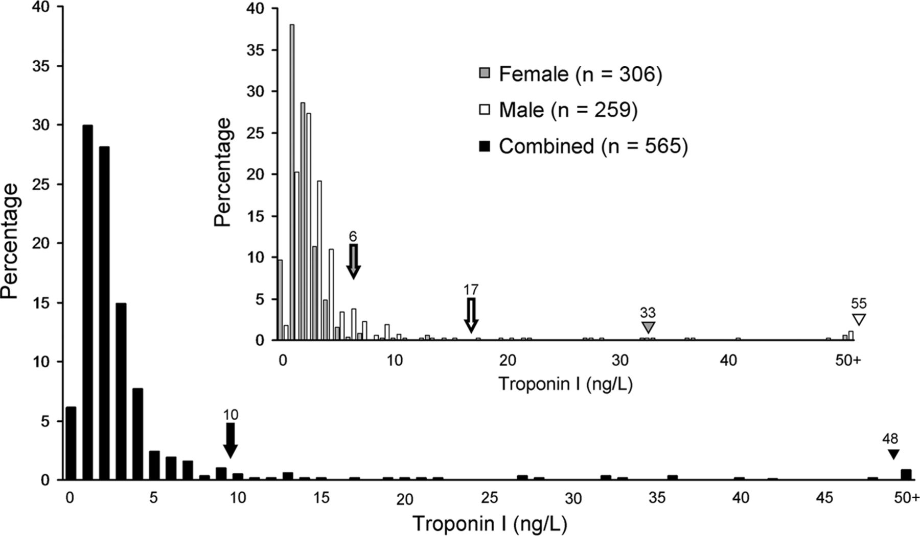
Threshold window of interest
48
Distribution of hs-cTn I in a healthy reference cohort
Mckie et al. Clinical Chemistry Vol 59 (7), 2013
Notes:
Distribution of hs-cTnI results in the healthy reference cohort (n = 565).
Distribution by female (n = 306) and male (n = 259) sex is also shown. The inverted triangle denotes the 99th percentile URL. Black, total population; gray, female; white, male. These data determined the sex combined and sex specific URL for subsequent analysis. Threshold window of interest includes women below the overall cut-point but above the female-specific cut-point.
Level of cTn in healthy population is lower in females than in males
99th percentile threshold for hs-cTn, is therefore lower in females compared to males

Slide 7
Mechanisms contributing to the discrepancy in the hs-cTn levels between men and women
Romiti et al. Cardiovascular Therapeutics, vol. 2019, Article ID 9546931, 12 pages, 2019

Slide 8
Sex-specific hs-cTn Thresholds
  Recommended sex-specific thresholds for hs-cTn I and T currently approved in Canada:
99th Percentile* | Roche hs-cTn T | Abbott hs-cTn I | Beckman hs-cTn I | Siemens hs-cTn I**
Overall | 14 | 26 | 18 | 45
Female- specific | 9 | 16 | 12 | 39
Male - specific | 16 | 34 | 20 | 54
*Based on the International Federation of Clinical Chemistry and Laboratory Medicine (IFCC)
**Values are for Siemens Atellica. For Siemens Dimension VISTA the values are 58 ng/L for the overall threshold and 51 ng/L for female specific threshold.

Slide 9
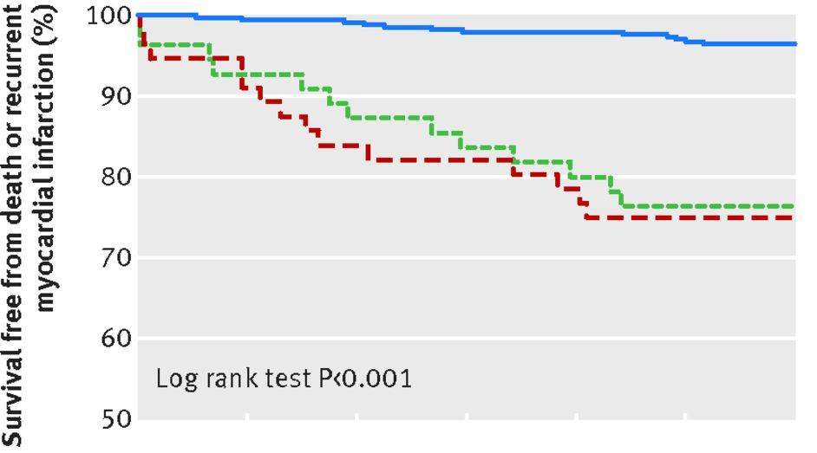
Outcomes by Threshold
Women with no MI
Women reclassified with MI based on sex-specific hs-cTn
Women with MI by single threshold
0 60 120 180 240 300 360
Survival free from death or recurrent myocardial infarction in women with Suspected Acute Coronary Syndrome. Shah et al. BMJ 2015;350
Notes:
Survival free from death or recurrent myocardial infarction in women and men with suspected acute coronary syndrome. Outcomes are shown for women and men with no myocardial infarction (group 1, solid blue line) and with myocardial infarction (group 3, dashed red line) where both assays were concordant, and for those reclassified as having myocardial infarction using the high sensitivity assay with sex specific thresholds (group 2, dashed green line)‏

Slide 10
Call to Action
Despite this evidence and guidelines recommending sex-specific thresholds, a single, overall cTn threshold is used in most clinical settings
Whether implementation of female-specific hs-cTn diagnostic thresholds improves outcomes through better targeting of treatments requires urgent attention
Notes:
Key point here is that even though thresholds vary by sex, unless this changes treatment and outcomes, there may be no rationale for using the lower threshold.

Slide 11
Specific Objectives:
Examine the impact of using a lower female-specific hs-cTn threshold on:
Diagnostic and therapeutic strategies
Prognosis: all-cause mortality, non-fatal MI, incident heart failure (HF) hospitalization or emergent/urgent coronary revascularization at one year
Costs of diagnostic testing and treatment
Notes:
Inclusion of health economics study is key to determine whether there is over-diagnosis and/or inappropriate treatment

Slide 12
Design: Stepped-Wedge, Cluster-Randomized
Clusters (hospitals) cross over sequentially, in random order, from control to intervention phase
At end of study all clusters in intervention phase
  Control Phase: Standard of care, with the use of single, overall hs-cTn threshold in both sexes
  Intervention Phase: Introduction of female hs-cTn threshold

Slide 13
Study Design and Timeline
Data linkage
Data compilation from all sites
Data transfer Storage and Analysis
12
Notes:
Control phase – standard of care; overall hs-cTn for both males and females
Intervention phase – female-specific hs-cTn threshold; males continue to be evaluated against overall threshold

Slide 14
Key Study Features
Hospital, not patient, consent
Evaluation of a change in process to routine clinical practice
Patients do not undergo any research-specific procedures
No screening or patient enrolment
Process change is applied to everyone during intervention phase
No data collection or follow-up
Study cohort and study outcomes are obtained from routine administrative data collection
At study end, all sites are using female-specific thresholds
Notes:
The key point here is there is no screening, enrolment, patient consent or data collection.

Slide 15
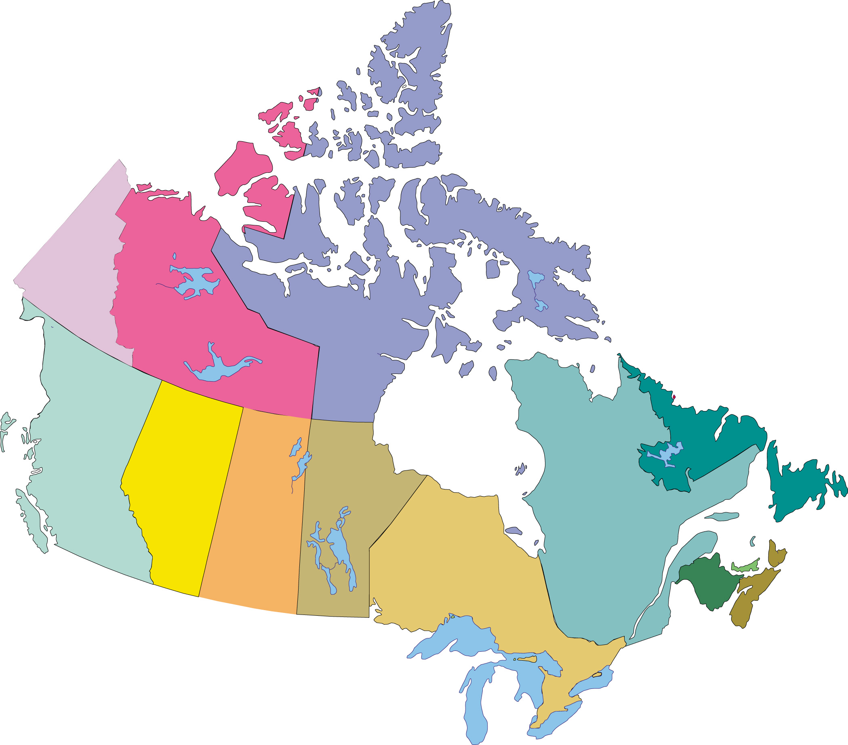

28 Sites, 8 Provinces across Canada
Notes:
If you hover over the ‘pins’ it will indicate the hospital name

Slide 16
Study Population
Inclusion:
Adults presenting to the emergency department (ED) with symptoms suggestive of ischemia, with at least one hs-cTn test result
  Based on CEDIS* codes: 003 (chest pain, cardiac), 004 (chest pain, non-cardiac, 651 (shortness of breath)
Exclusion:
  < 20 years of age
  Invalid personal health number
  Not resident in the same province
Note: STEMIs excluded: usually bypass ED, cTn not part of diagnostic work-up
  *Canadian Emergency Department Information System (CEDIS)

Slide 17
Primary Outcome
Efficacy:
Composite of all-cause mortality, non-fatal MI, hospitalization for incident HF, or urgent/emergent coronary revascularization at 1-year post index ED presentation (1-year MACE).
Safety:
BARC Definition for Major or Life-threatening Bleeding
BARC =The Bleeding Academic Research Consortium
Notes:
ICD-10 and CCI codes will be used to capture hospitalization and revascularization procedures, respectively. All-cause mortality will be obtained for Vital Statistics through CIHI for all provinces.

Slide 18
High-STEACS vs CODE-MI
The High-STEACS trial, published in September 2018, did not identify improved outcomes with sex-specific hs-cTn thresholds. However, there are important differences that support the need for CODE-MI:

Slide 19
Main Statistical Analysis
Comparing the 1-year MACE rates between the control and intervention phases among females with peak hs-cTn within the threshold window
Model: mixed effects logistic regression adjusted for site variation and any secular trend

Slide 20
Sample Size Considerations
Power calculations based on following assumptions:
12.2% 1-year MACE rate in control phase
recruitment of 127 females*per site per 5 months
two-sided likelihood ratio test at 0.05 α level
82% power to detect a 20% reduction in the odds of the composite endpoint during the intervention phase
Notes:
These are the main assumptions. The simulations are based on more assumptions, such as site variability etc.
Females with ischemic chest pain (CEDIS = 003, 004, 651) and peak cTn within the cutpoint window

Slide 21
Data Linkage
Linkage process varies by site
The process involves linking the following data sources:
  ED (NACRS) and Lab data
  Discharge Abstract Database (DAD)
  Provincial Prescription Database
  Physician Billing
  Vital Statistics
Data from all sites will be de-identified, stored and accessed for analysis via CIHI’s Secure Research Environment
study cohort
Notes:
Some sites can access NACRS and lab data from a provincial depository; others will obtain data from each hospital separately
Prescriptions and physician billing will be obtained at the provincial level
DAD and Vital Statistics are obtained from CIHI

Slide 22
Site Preparation Checklist
hs-cTn assay in use for at least 2 months prior to randomization
Cardiology, ED and Lab leads review/approve study logistics and hospital agrees to participate
Ethics approval / research contract set up for payment
Completed training using preferred modality (e.g videos, slide presentation, information sheets) 6-8 weeks prior to transitioning to intervention phase
IT department ready to make relevant changes to lab reporting system
Notes:
Training offers a suite of tools.

Slide 23
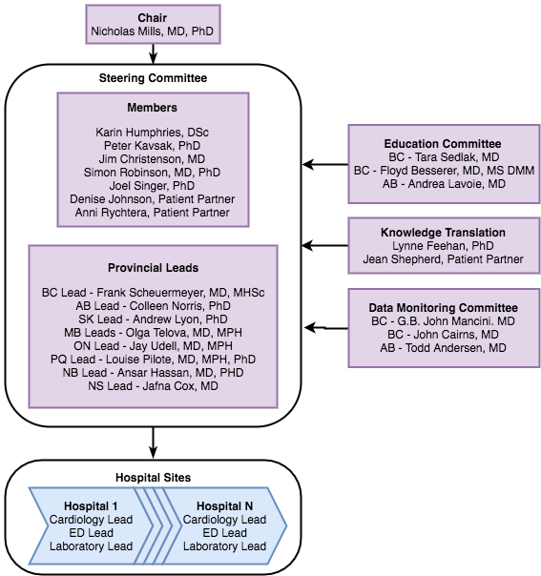
Study Organization:

Slide 24
Why Does this Matter?
The recommended 99th centile threshold for cTn in women is lower than the overall threshold which is currently being used, and lower than the 99th centile in men, for all hs-cTn assays.
Failure to take these differences into account may contribute to the under-diagnosis of MI and poorer outcomes observed in women compared to men.

Slide 25
What does this mean for your clinical practice, at {your site}?
The current overall 99th percentile threshold for hs-cTn {I or T} for both men and women is {value} ng/l.
The intervention phase (i.e the introduction of the lower female-specific hs-cTn) will begin on {date},at which point the new threshold for women will change to {value} ng/l.
The threshold for men will remain the same as the existing overall threshold at {value} ng/l .
Notes:
Please fill in the details: your site’s name, your site’s assay, the overall 99th percentile values as well as the female-specific threshold and the date for the switch to lower female threshold.
If possible, add what the change would look like on lab reports. Will it be reported as above or below a threshold or as a single value.
Including a screen shot of the lab reporting of the lower female-specific thresholds will be helpful as well.

Slide 26

CODE-MI ICVHEALTH Team
Karin Humphries MBA, DSc, FAHA
Principal Investigator
khumphries@icvhealth.ubc.ca
Salima Jutha B.Sc, CCRA
National Coordinator
CodeMI@icvhealth.ubc.ca
May Lee MSc
Senior Statistician
mklee@cheos.ubc.ca
Mona Izadnegahdar PhD
Epidemiologist
mizadnegahdar@icvhealth.ubc.ca
@CodeMICanada

Slide 27
Acknowledgements

Slide 28
Additional Slides

Slide 29
British Columbia
Provincial Lead: Dr. Frank Scheuermeyer
 | Lab | Cardiology | ED
St. Paul’s Hospital | Dr. Andre Mattman | Dr. Chris Fordyce | Dr. Frank Scheuermeyer
Royal Jubilee/ Victoria Genera Hospital | Dr. Gordon Hoag | Dr. Simon Robinson | Dr. Ross Hooker

Slide 30
Alberta
Provincial Lead: Dr. Colleen Norris
 | Lab | Cardiology | ED
University of Alberta Hospital | Dr. Albert Tsui | Dr. Michelle Graham | Dr. Bill Sevcik
Royal Alexander Hospital | Dr. Josh Raizman | Dr. Ben Tyrrell | Dr. Rebeccah Rosenblum

Slide 31
Saskatchewan
Provincial Lead: Dr. Andrew Lyon
 | Lab | Cardiology | ED
Royal University Hospital | Dr. Andrew Lyon | Dr. Paul Basran | Dr.Bruce Cload
Regina General Hospital | Dr. Ramesh Saeedi & Dr. Joshua Buse | Dr. Andrea Lavoie | Dr. Glenda Kaban/

Slide 32
Manitoba
Provincial Lead: TBD
 | Lab | Cardiology | ED
St. Boniface Hospital | Dr. Laurel Thorlacius | Dr. Shuangbo Liu/ Dr. Kunal Minhas | Dr. Paul Ratana

Slide 33
Ontario
Provincial Lead: Dr. Jay Udell
 | Lab | Cardiology | ED
Mount Sinai Hospital | Dr. Jennifer Taher and Dr. Barry Hoffman | Dr. Susanne Mak | Dr. Bjug Borgundvaag
Sunnybrook Hospital | Dr. Mark Cheung | Dr. Harindra Wijeysundera | Dr. Jacques Lee
Toronto General Hospital/ Toronto Western Hospital | Dr. Vathany Kulasingam | Dr. Jay Udell | Dr. Steven Friedman
St. Michael’s Hospital | Dr. Daniel Beriault | Dr. Akshay Bagai/ Dr. Beth Abramson | Dr.Brian Steinhart
Kingston General Hospital | Dr. Michael Chan | Dr. Amer Johri | Dr. Marco Sivilotti

Slide 34
Ontario - continued
 | Lab | Cardiology | ED
Ottawa Hospital General Site | Dr. Ron Booth | Dr. Habibat Garuba | Dr. Venkatesh Thiruganasambandamoorthy
Ottawa Hospital Civic Site | Dr. Christopher McCudden | Dr. Derek So | Dr. Venkatesh Thiruganasambandamoorthy
Hamilton General Hospital (Hamilton Health Sciences) | Dr. Peter Kavsak | Dr. Eva Lonn | Dr. Andrew Worster
Juravinski Hospital (Hamilton Health Sciences) | Dr. Peter Kavsak | Dr. Eva Lonn | Dr. Andrew Worster
William Osler Health System (Peel Memorial, Brampton Civic, Etobicoke General) | Dr. Saranya Arnoldo | Dr. Dominic Raco | Dr. Oscar Karbi
University Hospital (London Health Sciences) | Dr. Vipin Bhayana | Dr. Neville Suskin | Dr. Jonathan Dreyer
Victoria Hospital (London Health Sciences) | Dr. Vipin Bhayana | Dr. Neville Suskin | Dr. Jonathan Dreyer

Slide 35
Quebec
Provincial Lead: Dr. Louise Pilote
 | Lab | Cardiology | ED
Montreal General (MUHC) | Dr. David Blank | Dr. Richard Haichin | Dr. Greg Clark/ Dr. Jean-Marc Troquet
Royal Victoria Hospital (Glen Site) | Dr. David Blank | Dr. Richard Haichin | Dr. Greg Clark/ Dr. Jean-Marc Troquet
Montreal Heart Institute | Dr. Joel Lavoie | TBD | Dr. Alain Vadeboncoeur/ Dr. Michele Lucey
Jewish General | Dr. Shaun Eintracht | Dr. Annabel Chen-Tournoux | Dr. Marc Afilalo
St. Mary Hospital | Dr. Julie St-Cyr | Dr. Mathieu Walker | Dr. Suj Sivaraman

Slide 36
New Brunswick
Provincial Lead: Dr. Ansar Hassan
 | Lab | Cardiology | ED
Saint John Regional Hospital | Dr. Jennifer Shea | Dr. Sohrab Lutchmedial | Dr. Kavish Chandra

Slide 37
Nova Scotia
Provincial Lead: Dr. Jafna Cox
 | Lab | Cardiology | ED
Queen Elizabeth II Hospital | Dr. Amy Lou | Dr. Ata Quraishi/ Dr. Sharon Mulvagh | Dr. Sam Campbell

Slide 38
High-STEACS vs CODE-MI
The High-STEACS trial, published in September 2018, did not identify improved outcomes with sex-specific hs-cTn thresholds. However, there are important differences that support the need for CODE-MI:

Slide 39
Secondary Outcomes
Components of the 1-year composite outcome with death, to account for competing risk:
  1-year non-fatal MI or all-cause mortality
  1-year urgent/emergent coronary revascularization or all-cause mortality
  1-year hospitalization for HF or all-cause mortality

Slide 40
Secondary Outcomes
Proportion of patients who:
  Fill at least one prescription for evidence-based cardiac medications (beta-blockers, ACE-I/ARB, statins, anti-platelets)
  Undergo diagnostic tests (nuclear medicine cardiac scan, exercise stress test, diagnostic cardiac catheterization/CT angiogram or echocardiogram) within 90 days of the ED visit
Length of stay during the index admission
  Health care utilization and cost associated with:
    Relevant physician visits, diagnostic testing, ED visits, hospitalizations and length of stay, and cost of prescription dispensing

Slide 41
Planned Sub-group Analyses
1-year MACE outcome in females with CEDIS = 003 and peak hs-cTn within the threshold window of interest by:
  age: < 60 vs ≥ 60 years
  Assay: cTnT vs I
  Chronic renal disease
  Diabetes
  Chronic heart failure

Slide 42
Exploratory Analyses
  Females with peak hs-cTn outside the threshold window of interest
  Male patients
  STEMI Patients

